Slide 1
Machine Translation Using Seq2Seq Modelling
By Rachana Movva
Manasa

Slide 2
Machine Translation
Machine translation uses software to translate text or speech from one language to another
Previously Machine translation engine performs simple substitution of words in one language for words in another
For more accurate translation, recognition of whole phrases and their closest counterparts in the target language is needed
For this we need to create an intelligent Machine
Currently we have neural network to add intelligence. The models are called Neural Machine Translation

Slide 3
Project Overview
The aim of the project is to create a Neural Machine Translation which translate English to French
The neural translation model is an encoder-decoder recurrent neural network
It is comprised of an encoder that reads a variable length input sequence and a decoder that predicts a variable length output sequence.

Slide 4
Data and Preprocessing Steps
Data is taken from Europarl Machine Translation Dataset
Data Preprocessing
    Tokenization
    Normalizing tokens to lower case
    Removing punctuations
    Removing Non-Printable format
    Removing words that contain Non alphabetic characters
    Converting Text to sequences
    Padding the sequences to Maximum length

Slide 5
Teacher Forcing
Teacher forcing works by using the actual or expected output from the training dataset at the current time step y(t) as input in the next time step X(t+1), rather than the output generated by the network.

Slide 6
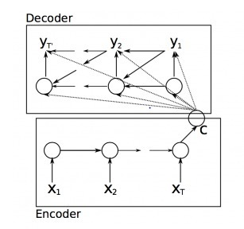
LSTM based Sequence to Sequence learning

Slide 7
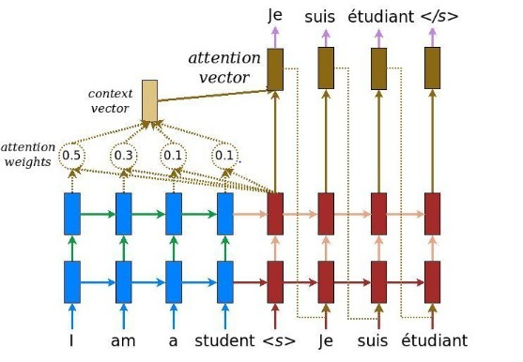
Attention

Slide 8
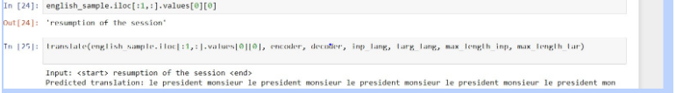
Analysis and Results
Input size:1000,epochs=25

Slide 9
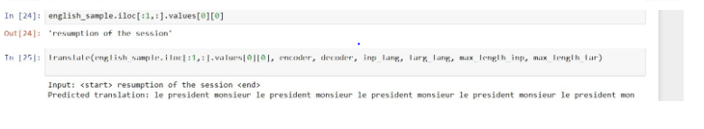
Input size:1000,epochs=50

Slide 10
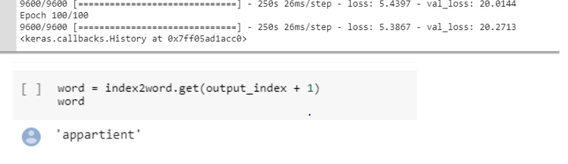
Sequence to Sequence
Input size: 9984, epoch: 100

Slide 11
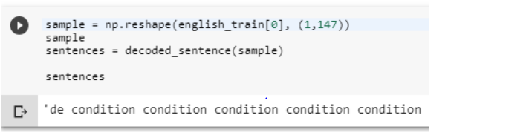
Sequence 2 Sequence
Input size: 25000, epoch:10

Slide 12
Summary of the Experiments
Model | 10 Epochs/Samples | Training time/epoch
LSTM(Sequence to Sequence) | 20/15000 | 16 minutes
LSTM(Sequence To Sequence) | 10/20000 | 10 minutes
LSTM(Sequence To Sequence) | 10/25000 | 10 minutes
Attention Model 1 | 100/1000 | 6minutes
Attention Model 2 | 50/1000 | 6.1minutes
Attention Model 3 | 25/2000 | 14 minutes

Slide 13
Conclusion
In the experiments conducted to find out best model for translation, we found out that Attention model with 1000 input size and 50 epoch has given the least loss and reasonably good translation from English to French.

